Slide 1

Synthetic Probabilistic Temporal Networks
Network Science Project - Group 1
Deep Inamdar
Riley Gusa

Slide 2
Intuitive Approach
Nodes
Node Creation Rate
Node Life
Edges
Edge Creation Probability
Edge Deletion Probability
Edge Weight
Dependencies
Time
Graph Properties
Node Properties
Meta Data

Slide 3
Conceptual Model
temporalNetwork(G, ncr, nlf, ecf, edf, ewf, meta(…))
Parameters | Explanation | Return Value
G | Initial Graph Instance | NA
Node Creation Rate Function | ncr = f(G, t) | Integer
Node Life Function | nlf = f(G, v, t) | Integer
Edge Creation Function | ecf = f(G, v1, v2, t) | Probability
Edge Deletion Function | edf = f(G, v1, v2, t) | Probability
Edge Weight Function | ewf = f(G, v1, v2, t) | Bounded Real
Meta Data | t_start, t_end, unit_time, isDirected, isWeighted,selfLoops, etc.

Slide 4
Simulation of Temporal Network Construct Dummy Social Network Model
Parameter | Function
Node Creation Rate | return (exp(t/15)) # Exponential with time
Node Life | return (100*random(0.5-1)) # 50-100 age
Edge Creation | 1/(sigmoid(age-v1)*degree-v1)(sigmoid(age-v2)*degree-v2)(n) # Inversely proportional to degree, age, and total nodes.
Edge Deletion | return(0.1) # Simple probability of 0.1 always

Slide 5
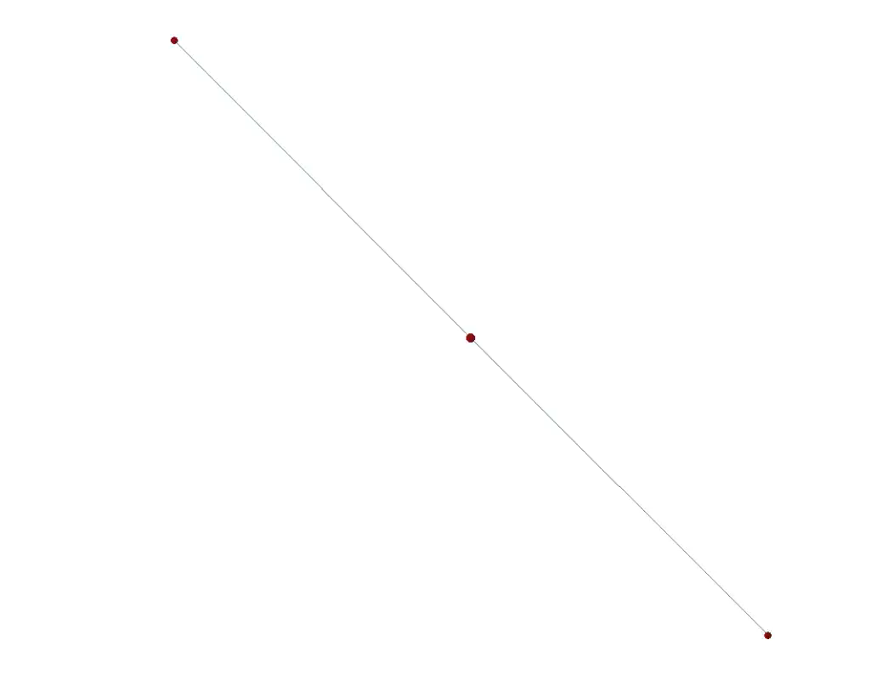
Simulation Video

Slide 6
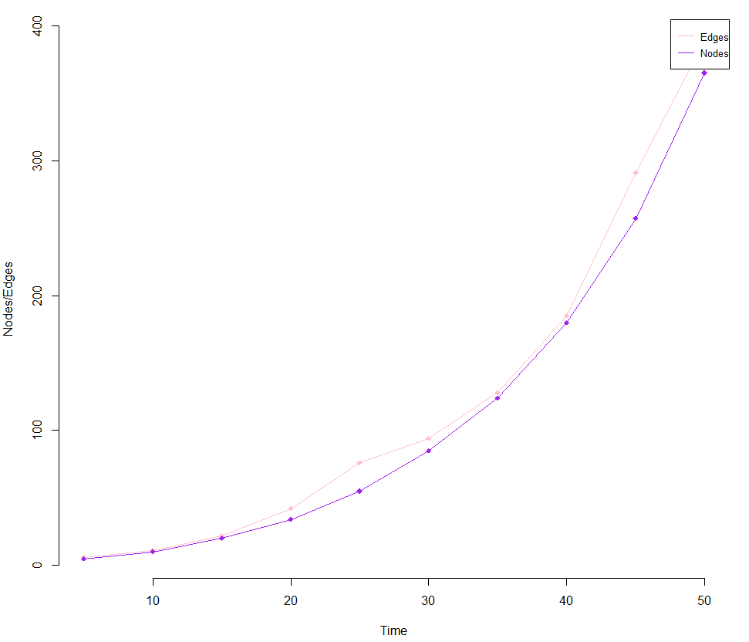
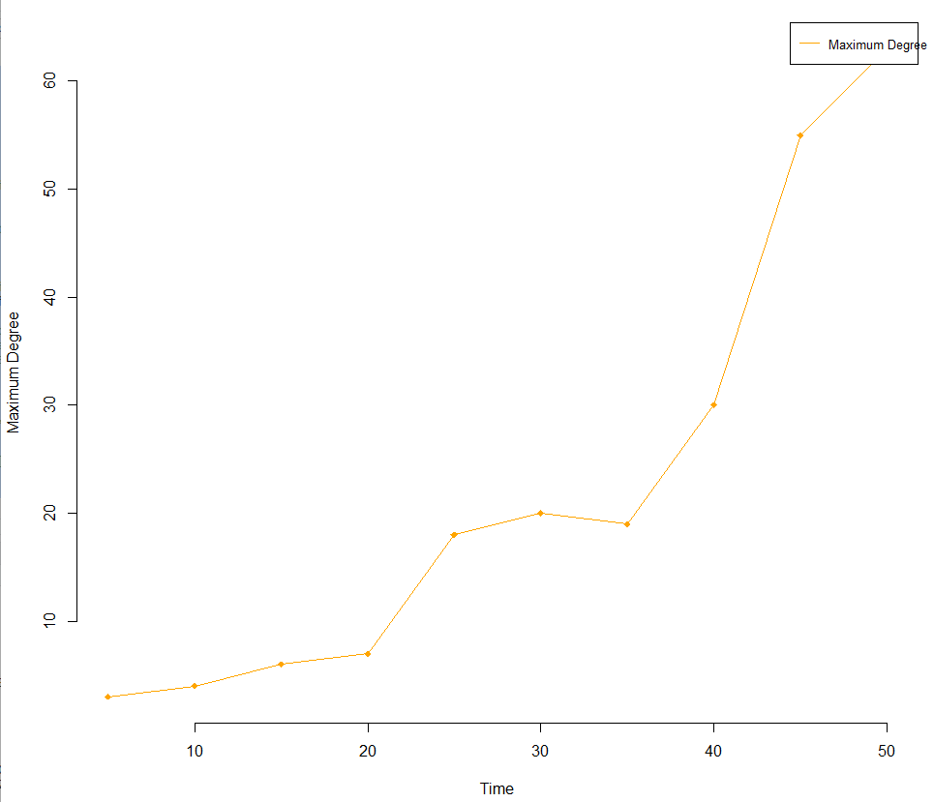
Temporal Analysis

Slide 7
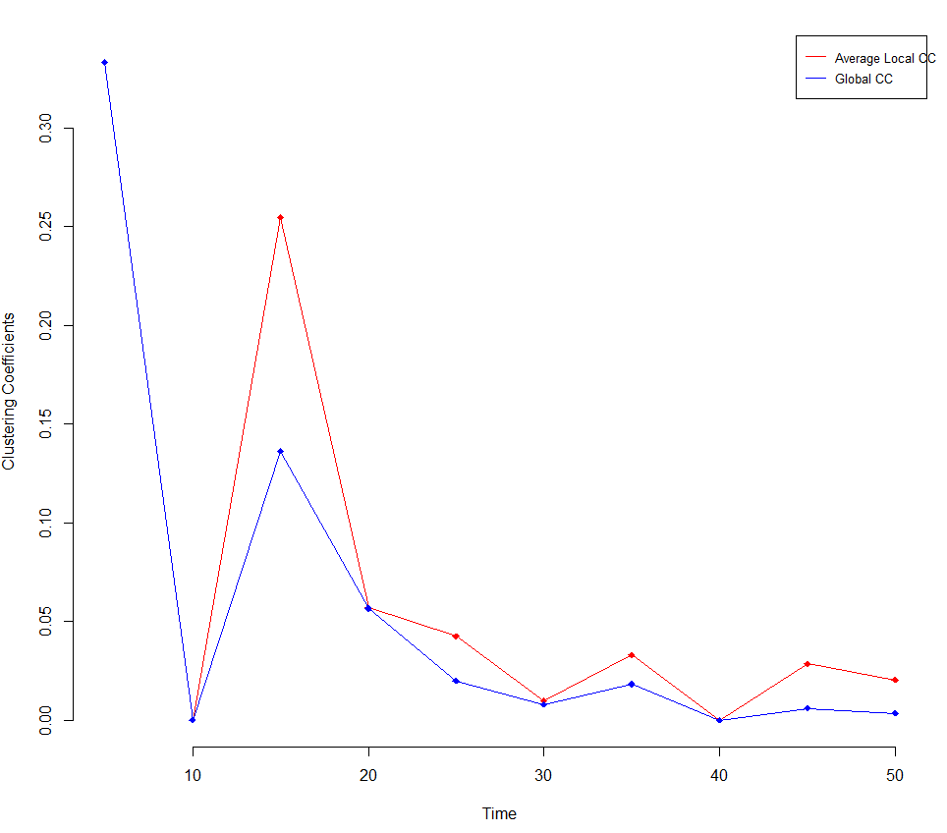
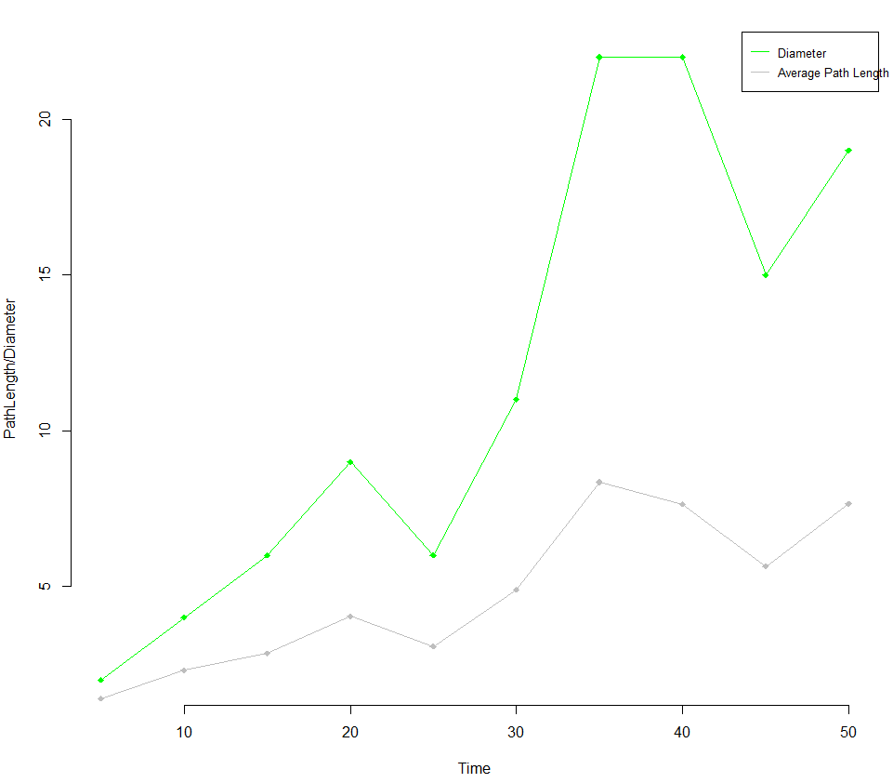
Temporal Analysis

Slide 8
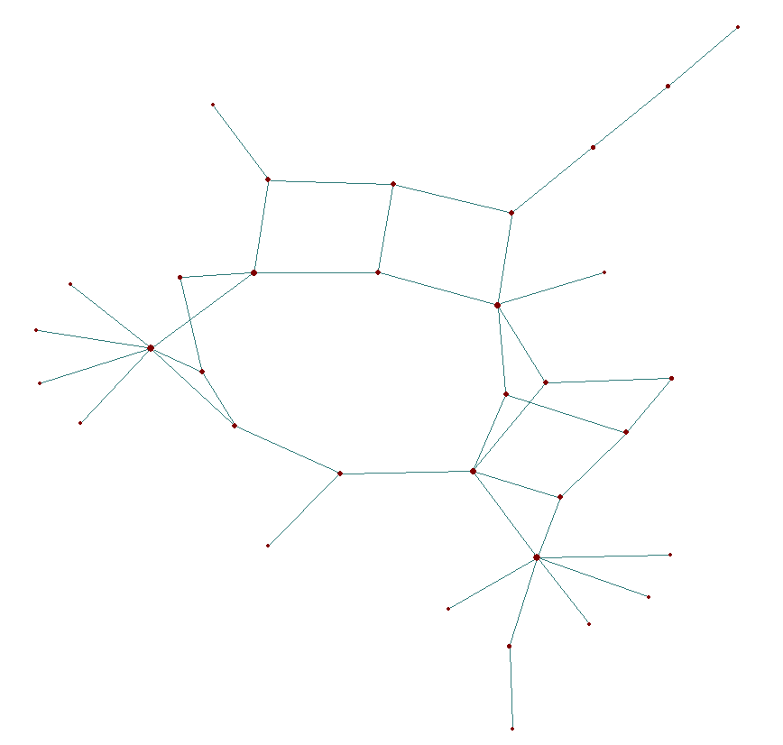
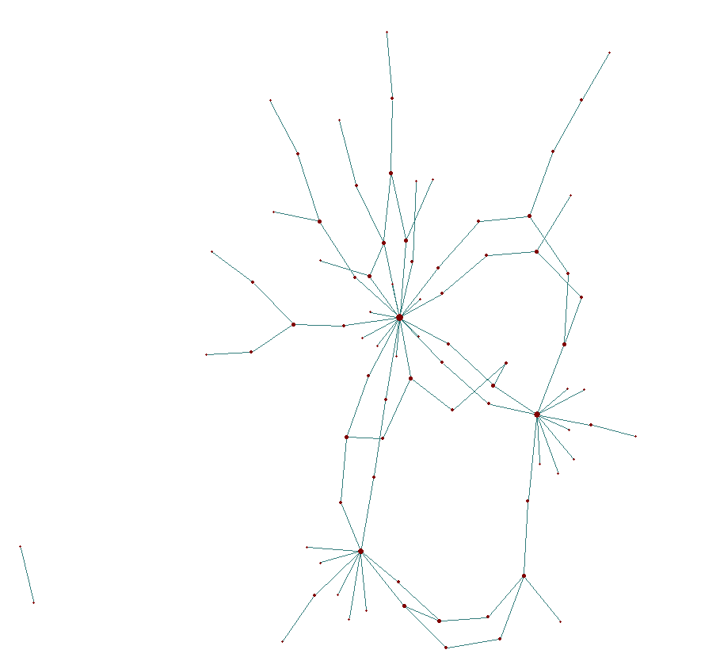
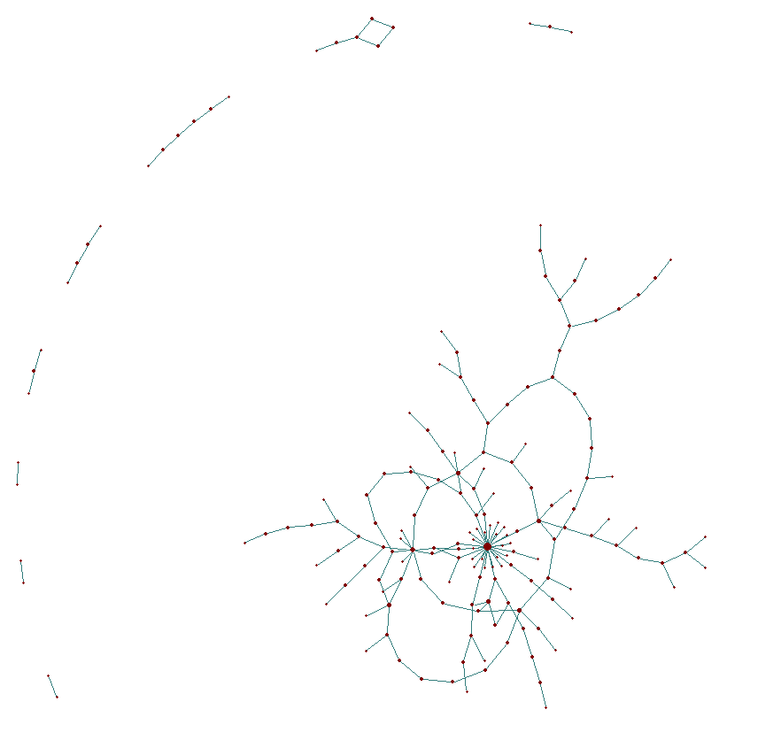
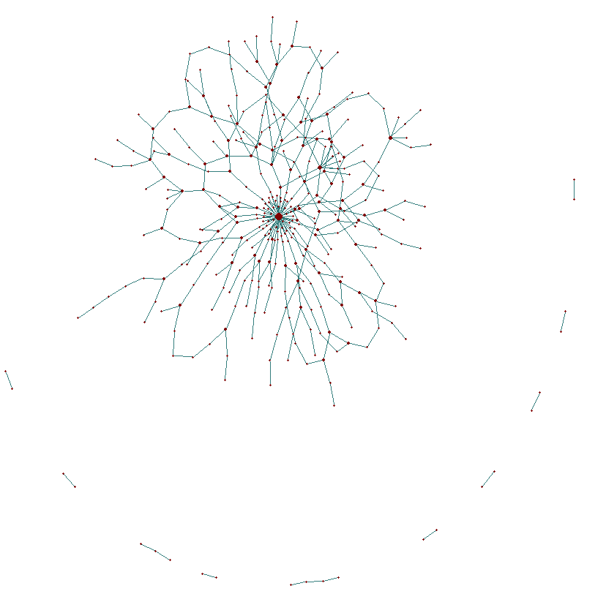
Evolution
T = 10
T = 30
T = 40
T = 50

Slide 9
Temporal vs Erdos Reyni
Nodes (n) = 1000
Edge Creation Probability (p) = 0.1
Undirected
Unweighted
No self loops
T = 50 (50 snapshots from n=0 to n=1000)
Parameter | Function
Node Creation Rate | return (200) #200 new nodes per unit time
Node Life | return (200) #No deletion of node
Edge Creation | if(get.vertex.attribute(G, "timestamp",v1)==t) return(0.1) else return(0) # Mimic Erdos Reyni Process
Edge Deletion | return(0) #No deletion of edge

Slide 10
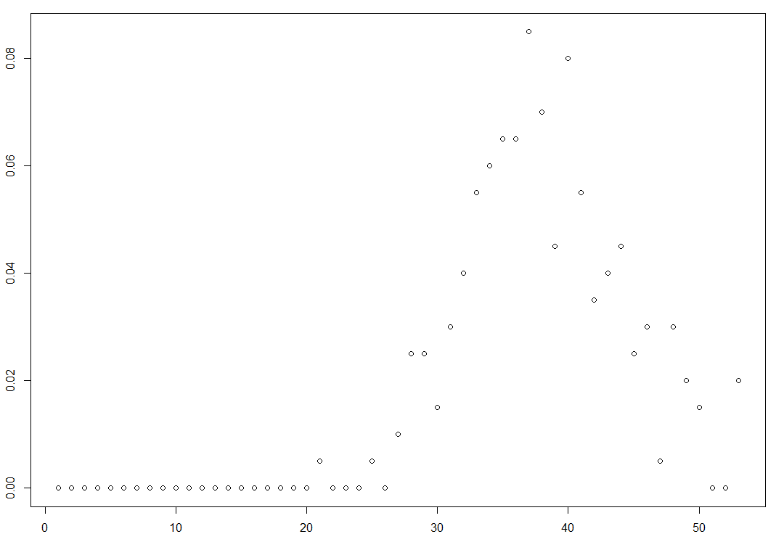
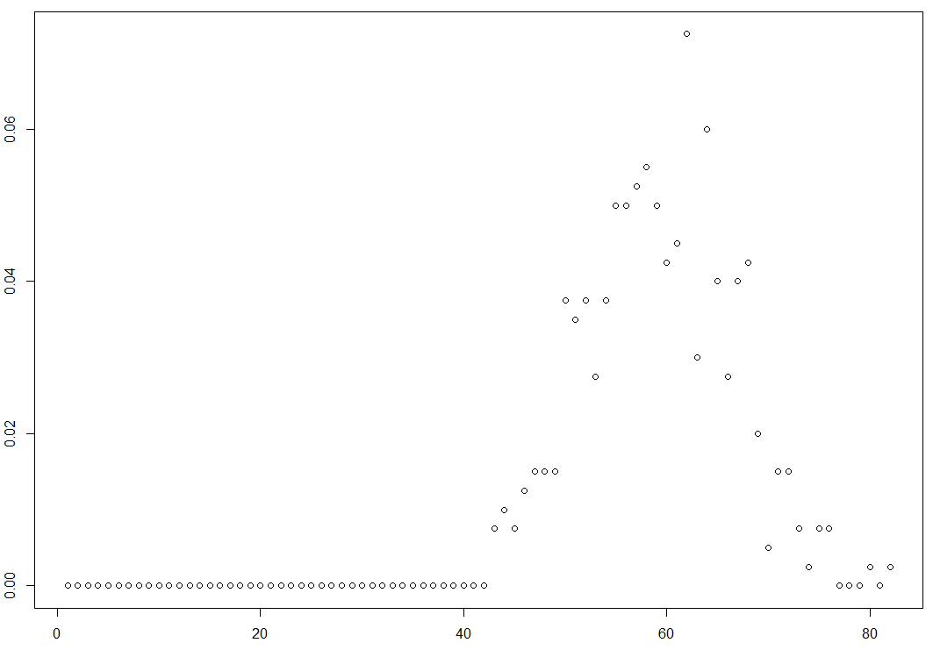
Degree Distribution T=10
Degree Distribution T=20

Slide 11
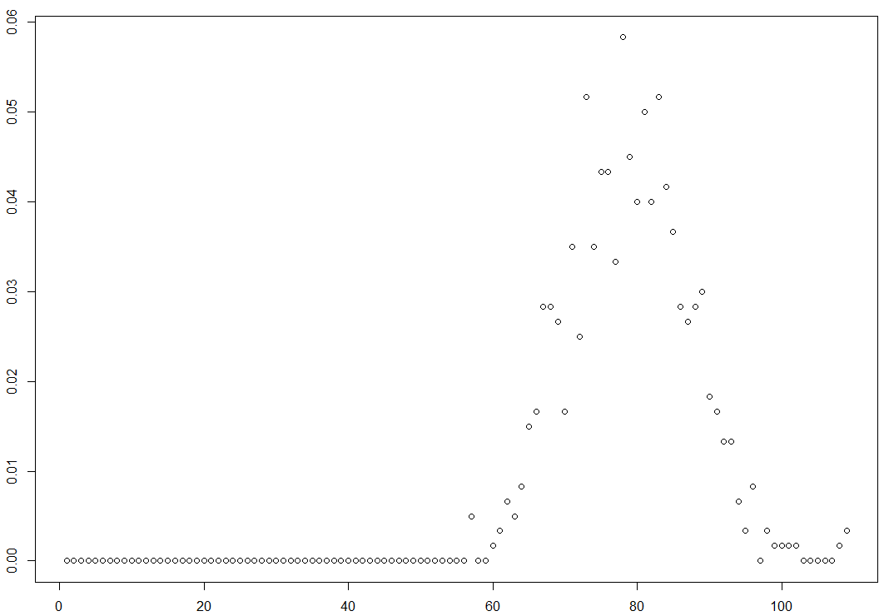
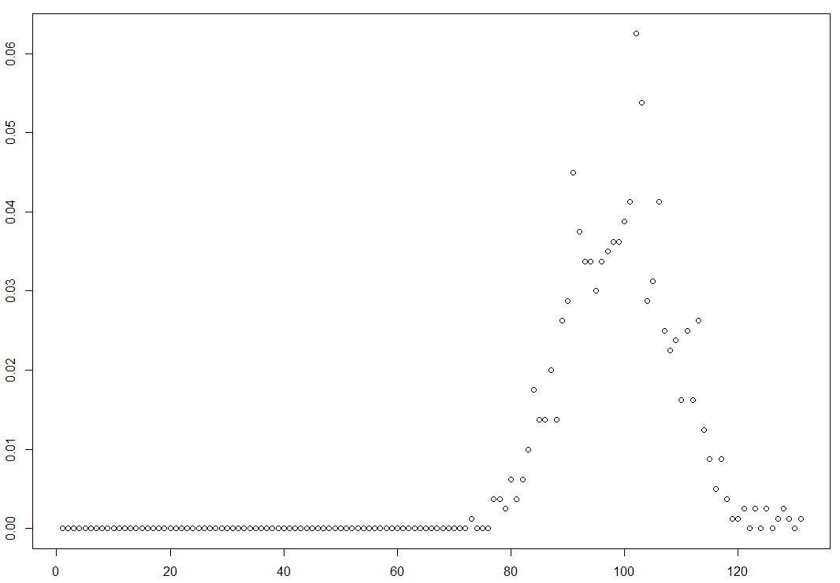
Degree Distribution T=30
Degree Distribution T=40

Slide 12
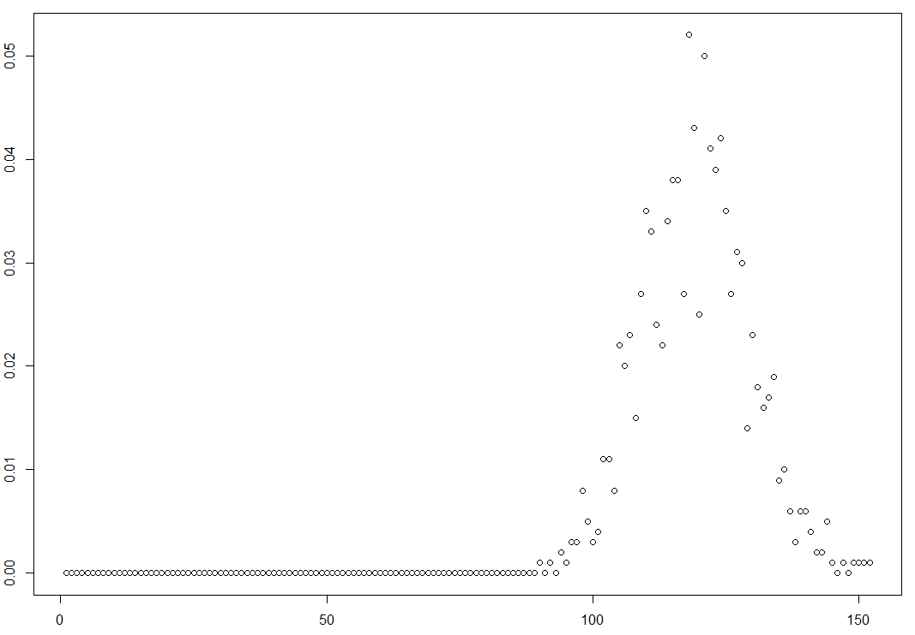
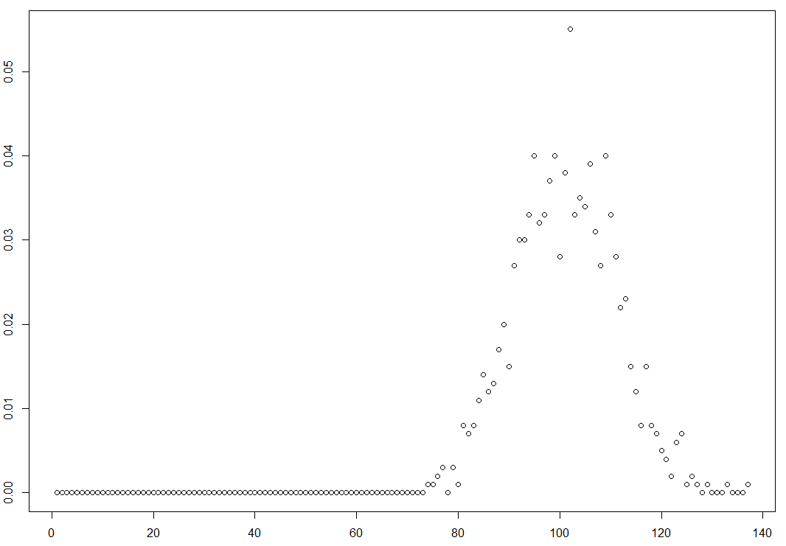
Degree Distribution T=50 (Nodes = 1000)
Degree Distribution Erdos Reyni (Nodes = 1000)

Slide 13
Static Analysis
Indicator | T=200 | T=400 | T=600 | T=800 | T=1000 | Erdos Reyni
Nodes | 200 | 400 | 600 | 800 | 1000 | 1000
Edges | 3721 | 11652 | 23367 | 39334 | 59119 | 50089
Average Degree | 37.21 | 58.26 | 77.89 | 98.335 | 118.238 | 100.178
Maximum Degree | 52 | 81 | 108 | 130 | 151 | 136
Components | 1 | 1 | 1 | 1 | 1 | 1
Average Path Length | 1.81391 | 1.85418 | 1.86999 | 1.87693 | 1.88164 | 1.89977
Diameter | 3 | 3 | 3 | 3 | 3 | 3
ALCC | 0.18765, | 0.15074, | 0.13294, | 0.12499, | 0.12007, | 0.11732
GCC | 0.18675 | 0.15045 | 0.13283 | 0.12493 | 0.12003 | 0.11632

Slide 14
Reproducing Signed Temporal Network
Parameter | Function
Node Creation Rate | return (3) # Create 3 nodes per unit time
Node Life | return (5) # Node life is 5 units time
Edge Creation | return (0.1) # Simple low probability
Edge Deletion | return(0.8) # Simple high probability
Edge Weight | if(random(0-1)<0.5) { return(1) } else { return(2) } # 50% probability for +ve/-ve edge creation

Slide 15

Signed Temporal Network Simulation

Slide 16

Pros
Flexibility: In terms of functional inputs for feeding in realistic probabilistic values.
Proposed model is closer to real-life structure.
Proposed model can handle undirected, directed, and weighted and graphs.

Slide 17
Cons
Sometimes too much flexibility is also a curse.
The model should be more thoughtful from scalability aspect.

Slide 18
Applications
Temporal model can be used to replicate real-world networks.
The proposed model being flexible can be used to visualized proposed strategies before implementation.
Experimenting with temporal analysis.
Predictive analysis on evolving networks.
E.g., Pandemic, Power Grid, Social Network.

Slide 19
Project scope
Compare the model with other static models such as Barabasi-Albert, R MAT, and BRET.
Static analysis can be more robust by including other indicators in evaluation and analysis.
Generate Balanced Signed-Network and do a signed network analysis.

Slide 20
Future Scope
An additional piece we would like to add to this synthetic temporal model is a machine learning tool that uses temporal graphs as a training data set and creates a theoretical strategy to predict temporal graph dynamics.

Slide 21
Thank You

Slide 22


Question and Answers

